Slide 1
Power Of Media
By – Influencer VERMA

Slide 2
• Media is being as “communication” channels through which news, entertainment, education, data or promotional messages are disseminated.”
• Media is very useful in day to day life because we get different news by media what had happen in bollywood, in politics, in Hollywood, in different states by media.

Slide 3
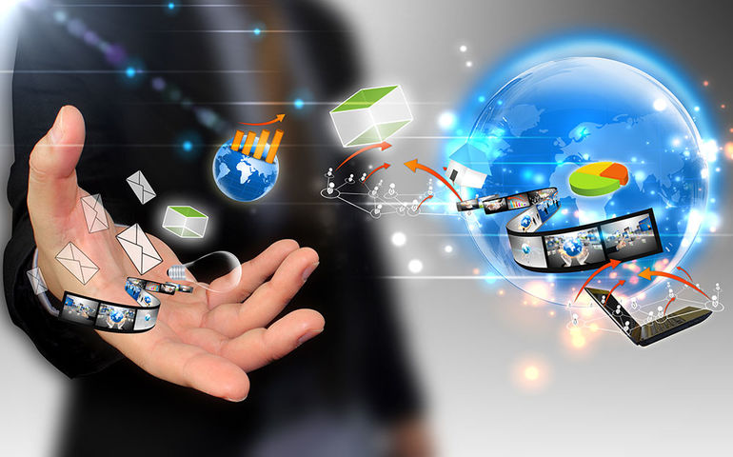
Media is catches different footages what is happening which is wrong or right or having different perspective to it.

Slide 4
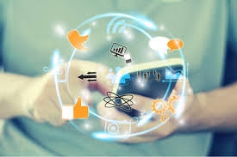
USES OF SOCIAL MEDIA
Reach a large audience..
Stay up to date..
Get connected to new people..
Build your brand..
Create your audiences..
Free to use…

Slide 5
Thanks for visiting

